Slide 1
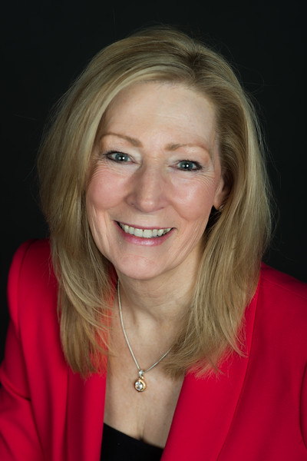
Meet your presenter
KAREN CLEVELAND , President and CEO
Karen is the President and CEO of Leadership Fairfax. Prior to joining Leadership Fairfax, Karen was the principle of Cleveland Group, LLC and Cleveland Coaching Group, Reston, VA based companies specializing in helping leaders, teams and organizations identify and develop their full leadership potential.
Previously, Karen served as President & CEO of Habitat for Humanity of Northern VA where she was known as a visionary leader and was credited with growing the organization into one of the most respected charitable organizations in the Metro DC area.

Slide 2

Leadership Fairfax
“where Fairfax finds leaders”

Slide 3
ABOUT US:
Mission: To inspire, connect, develop and engage leaders to impact issues facing Fairfax County and the region.
Established in 1987 with Fairfax Chamber of Commerce – Graduated inaugural class in 1988
Independent nonprofit organization since 1993
1,700+ alumni across all sectors - business, government and nonprofit.
Community Partner

Slide 4
Leadership Development Programs
Emerging Leaders Institute (ELI)
Designed for mid-level career professionals, interested in growing their leadership skills, competencies and community connections. Meets one full day a month, September to June.
Leadership Fairfax Institute (LFI)
Maximizes potential of senior leaders and C-suite executives to impact issues facing the region, and improve high level management capacity. Meets one full day a month, September to June.
Lifetime Leaders Program (LLP)
For seasoned professionals with a lifetime of experience looking for the next step after retirement. Helps individuals find ways to contribute to the community and have positive impact in various ways. Meets for six classes.

Slide 5
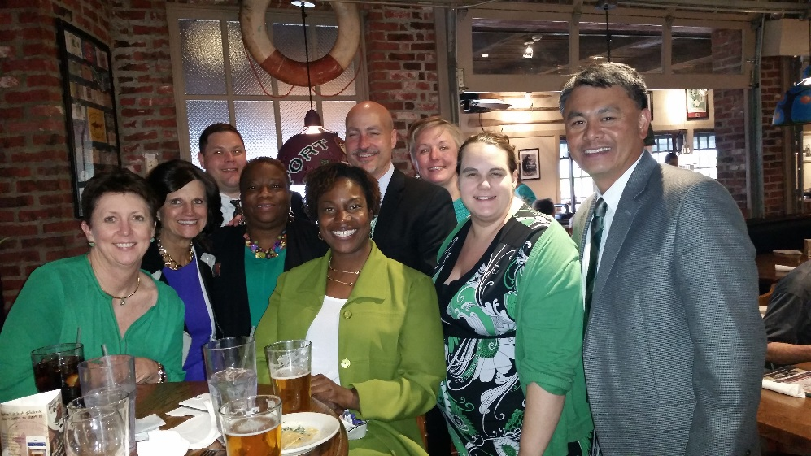
Leadership Fairfax signature Program (LFI)
Augment & learn leadership competencies
Connect with leaders & decision makers
Convene discussions & work to impact issues facing the region
Build your professional network
Explore Self-awareness, authenticity, leadership styles

Slide 6
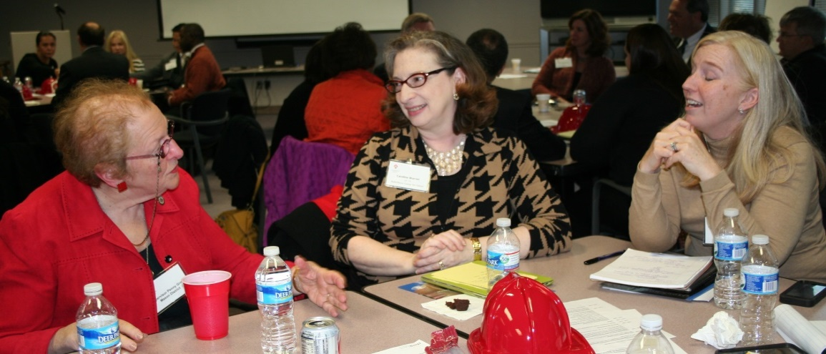
TYPICAL LFI Program Topics
Infrastructure
Education
Workforce Development
Healthcare
Affordable Housing
Diversity
Emergency Response
Social Services

Slide 7
2017 LFI PROGRAM Tuition
  $100 application fee
  $4,000 tuition
    All program costs, materials and DISC analysis
    Ten class days throughout the County and optional visit to Richmond General Assembly (Includes breakfast & lunch)
    Annual Alumni Reception
    Tickets to Leadership Fairfax events for member price
    Two tickets to Commencement
    Partial scholarships are available, based on need

Slide 8
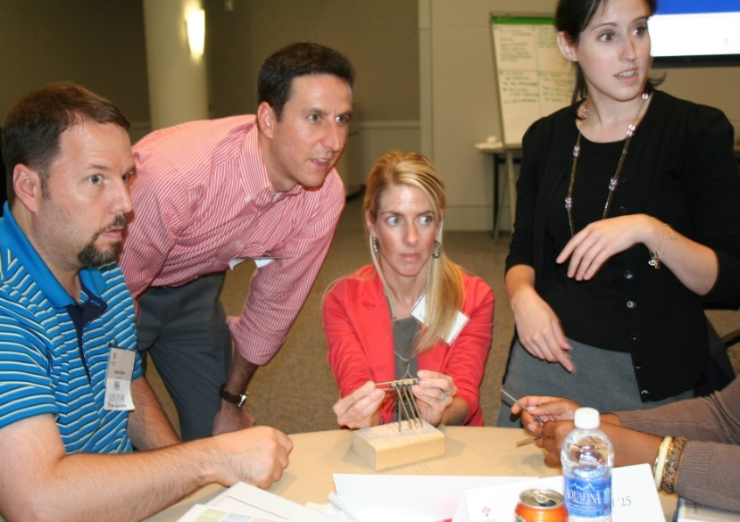
Emerging Leaders Institute (ELI)
Increase leadership skills, techniques & personal awareness
Work with a coach or mentor to focus on goals and development
Improve understanding of Fairfax County & regional operations
Engage with local nonprofit to complete service project
Build your professional network

Slide 9


TYPICAL ELI Program Topics
Negotiation Skills
Project Management
Public Speaking
Challenging Conversations
Healthy Workplaces
Ethical Decision Making
The Leadership Journey
Servant Leadership

Slide 10
2017 ELI PROGRAM Tuition
  $100 application fee
  $3,000 tuition
    All program costs, materials and DISC analysis
    Ten class days throughout the County at various corporate, government and nonprofit sites (Includes breakfast & lunch)
    Coaching and Mentoring
    Annual Alumni Reception
    Tickets to Leadership Fairfax events for member price
    Two tickets to Commencement
    Partial scholarships are available, based on need

Slide 11
Time Commitment?
Eli & LFI
Class program days = 1 full day/month for 10 months
Team time = approximately 40 hours
ELI: Jan – May: Project Planning and Implementation
LFI: Ongoing Planning and Implementation
Attendance and active involvement are expected.

Slide 12
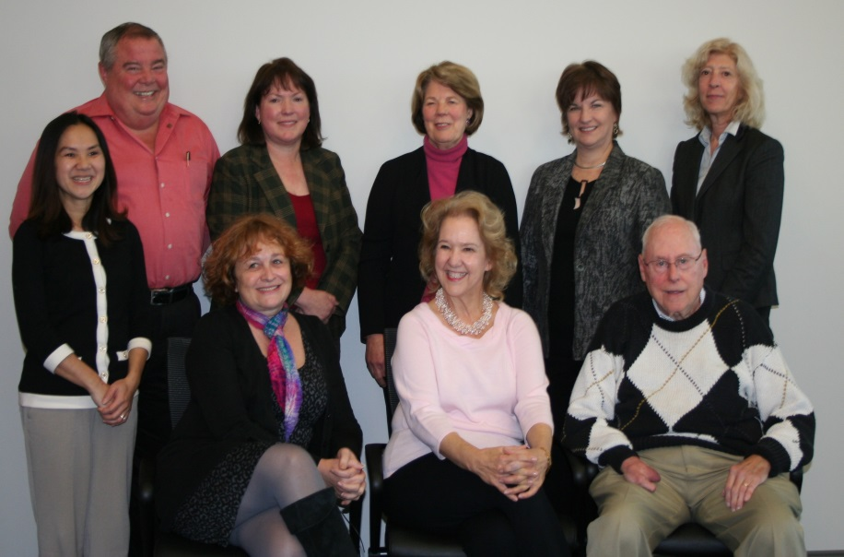
LIFETIME LEADERS PROGRAM (llp)
Define and create a meaningful and fulfilling retirement experience
Explore the concept of Lifetime Leadership
Explore encore careers
Build a personal network of community leaders
Recognize personal contribution and impact

Slide 13
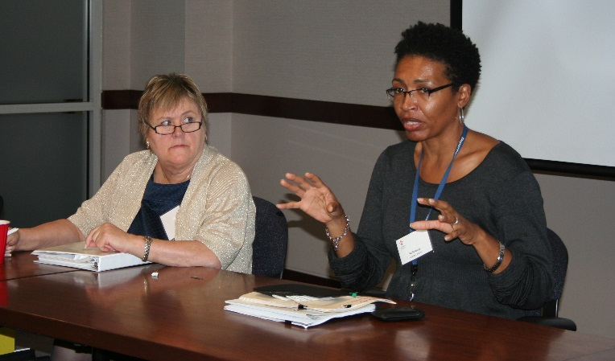
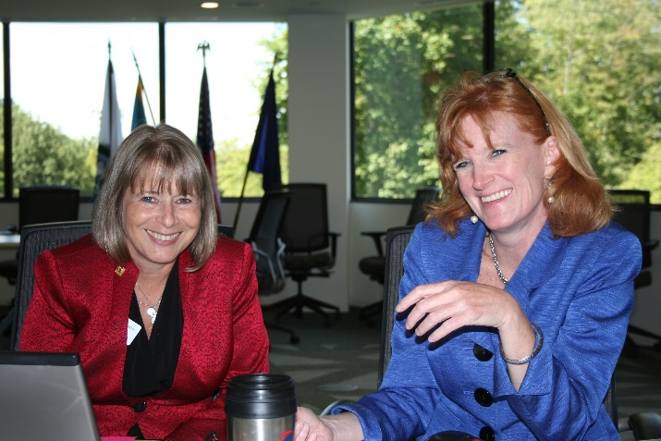
TYPICAL LLP Program Topics
Volunteerism
Fairfax County Government
Self-Awareness/ Reflection
Generativity Theory
Boardsmanship
Encore Careers
Leading in Retirement
Transition

Slide 14
2016 LLP PROGRAM Tuition
  $25 application fee
  $500 tuition
    All program costs and materials
    Six class days throughout the County at various corporate, government and nonprofit sites (Includes breakfast & lunch)
    Annual Alumni Reception
    Tickets to Leadership Fairfax events for member price
    Two tickets to Commencement

Slide 15
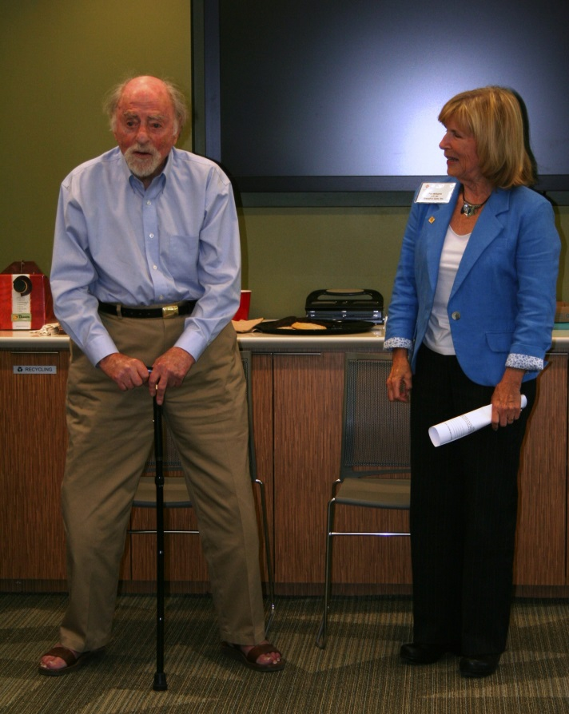
Application process
Applications on our website www.leadershipfairfax.org
Early Decision, March 31, 2017
Final, June 15, 2017
Decisions Announced July 2017
Programs start September

Slide 16
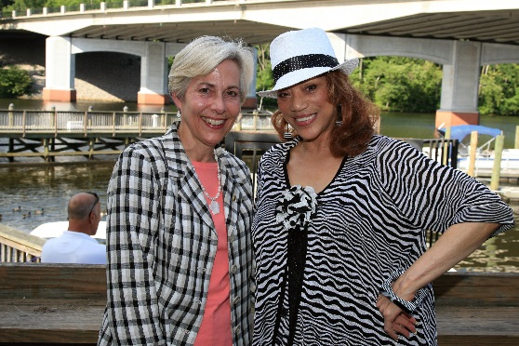
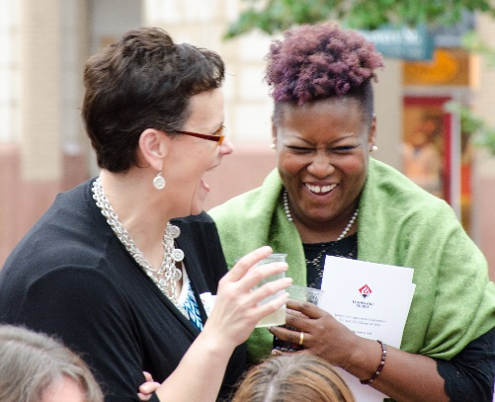
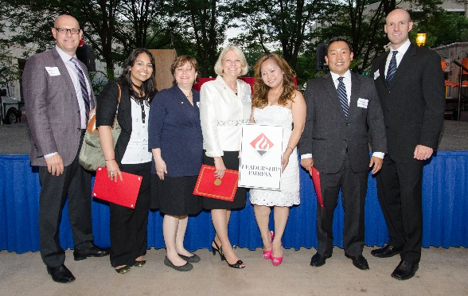

Leadership Fairfax events
Leadership Fairfax hosts fun events throughout the year too!
Annual Alumni Reception
Board of Supervisors Breakfast
Networking Events
Northern Virginia Leadership Awards
Class Commencement and Party
Volunteer Outreach

Slide 17
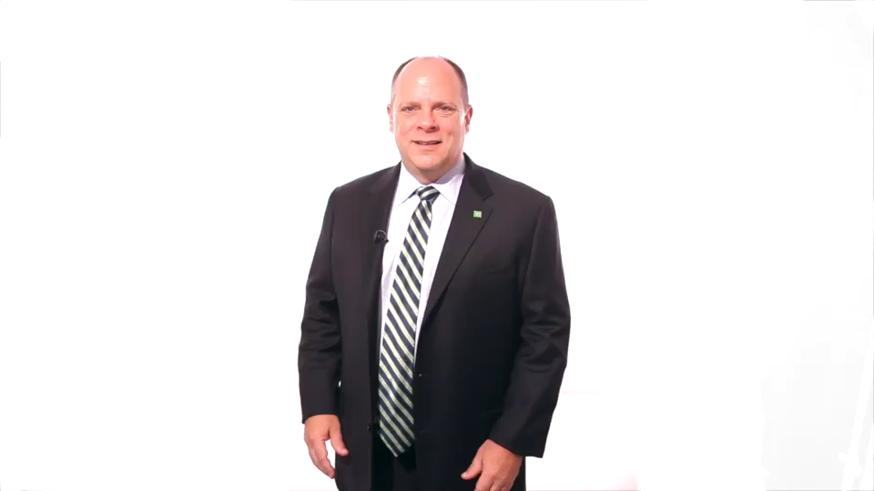
TESTIMONIALS

Slide 18
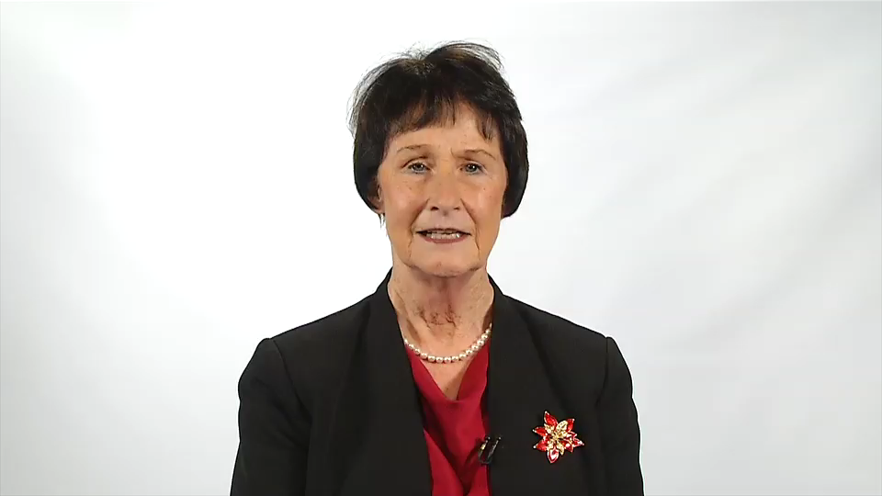
TESTIMONIALS

Slide 19

Leadership Fairfax
“where Fairfax finds leaders”

